Slide 1
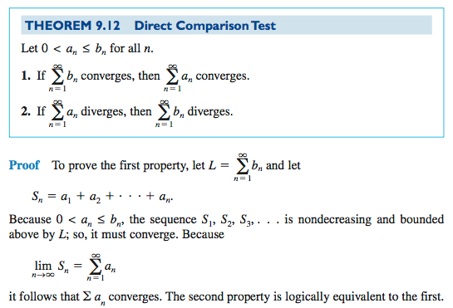
9.4 Direct Comparison
Test

Slide 2
Need to show:
Smaller than a converging or
Larger than a diverging
Like a geometric series, huh? r= 1/3
Like p-series, huh? p=1/2-- but not smaller
Like the harmonic, huh?-- that’ll do !

Slide 3
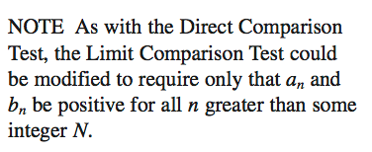

Slide 5
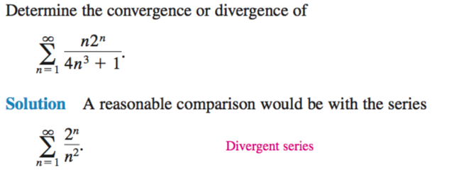
Like a p-series, huh? p=3/2
Check conditions: both series eventually always positive?

Slide 6
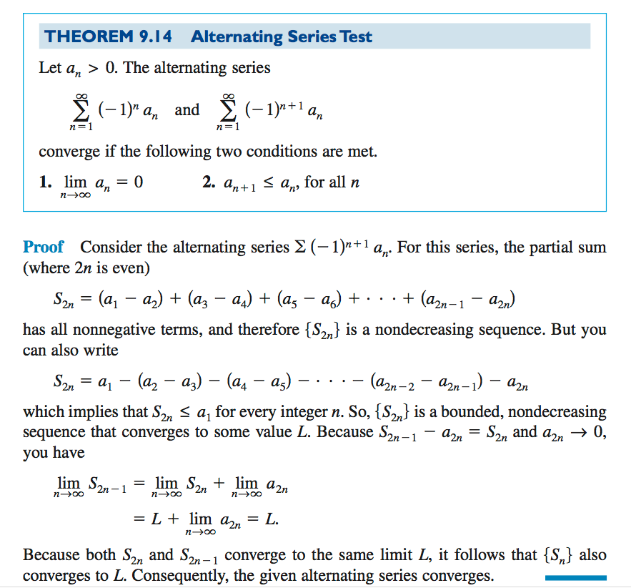
9.5 Alternating Series Test

Slide 7
Check conditions: decreasing and limit is 0

Slide 8
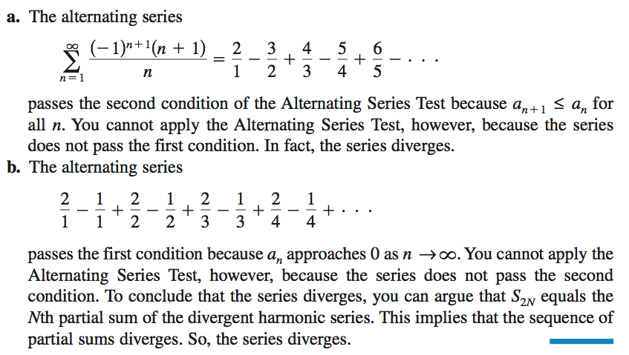
Warning: Sometimes the test fails (is inconclusive)

Slide 10
Does it converge?
The difference between the complete sum and the first 6 terms is less than the next term

